Slide 1
Routing an Express App

Slide 2




Our Team
Midhun Kandakatla
Bala Gopi Krishna
Sabbineni
Varun Goud Pulipalpula
Ravi Kumar
Atluri

Slide 3
Contents
Web Application
Client side and Server side Programing
Before Node JS
After Node Js
Routing
Routing without Express
Routing with Express
Middleware
Express Framework as Middleware
Midhun Kandakatla

Slide 4
CLIENT SIDE PROGRAMMING
Midhun Kandakatla

Slide 5
Client-Side Programming
What is client-side environment?
What is client-side programming language?
What are the main tasks of client-side programming?
Midhun Kandakatla

Slide 6
Client-Side Programming
The client side mainly involves with the UI(User Interface)
with which the client interacts with the server.
The client generates a request which is carried by the
browser to the server and server sends the
response(either positive or negative).
JavaScript(JS) is the present trending client side
programming language!
Midhun Kandakatla

Slide 7
SERVER-SIDE PROGRAMMING
Midhun Kandakatla

Slide 8
Server-Side Programming
What is server -side programming?
Why do we need server-side programming?
What are the major server-side programming languages?
Midhun Kandakatla

Slide 9
Server-Side Programming
Server side programming is to write programs
that run on server, using languages
that are supported by the server.
Web pages that come from .html are called
static web pages.
Web pages that are created on request are called Dynamic web pages.
We use server-side programming to create Dynamic web pages since this pages run on web server.
Midhun Kandakatla

Slide 10
Before nodeJs
Web applications were written in a client/server model where the client would demand resources from the server and the server would respond with the resources.
The server only responded when the client requested and would close the connection after each response.
Threads are a way for systems to run multiple operations concurrently. So every request would open a new thread, every thread had all it required to run the same code to completion.
But this system has a downside. It would get to a point where there’s a lot of requests and then starting up new threads would consume a whole lot of memory and system resources
Bala Gopi Krishna Sabbineni

Slide 11
Before nodeJs(con...)
But it’s also a good thing that immediately the server responds to the browser, the connection is closed and all resources (memory etc) are retrieved.
A benefit of this system is that it excels at CPU intensive applications.
To overcome these problems we an use NodeJs in writing Web Applications.
Bala Gopi Krishna Sabbineni

Slide 12
After NodeJs
In Node, while the file system is reading the file, Node uses the idle time to handle other requests.
Node is primarly made of java script and event loop.
Then the file system is done, it’s smart enough to tell Node to come take the resource and send to the browser. This is possible because of Node’s event loop.
Then with help of Node's "event loop" ,It was smart enough to tell Node to come take the resource and send to the browser.
Bala Gopi Krishna Sabbineni

Slide 13
After NodeJs(con...)
Unlike other languages that require a new thread or process for every single request, NodeJs takes all requests and then delegates most of the work to other system workers.
A "Libuv" library which handles this work effectively with help from the OS kernel.
A "Libuv" library which handles this work effectively with help from the OS kernel and uses "call backs".
NodeJs is extreamly faster than mullti-threaded systems. Even with a single thread.
It’s also important to know that everything in JavaScript runs parallel except your code
Bala Gopi Krishna Sabbineni

Slide 14
Routing
A server stores lots of files, when browser request, they tell the server what they are looking for. The server responds accordingly by giving them files they ask for. This is called Routing.
Routing with Express
If you’ve done some underground research, you must have heard about Express. It’s a NodeJs framework for easily building web apps and APIs. Since you want to write NodeJs apps, you’ll need Express too. It makes everything easier.
Varun Goud Pulipalpula

Slide 15
Routing without Express
var http = require('http');//create a server object:
http.createServer(function (req, res) {
res.writeHead(200, {'Content-Type': 'text/html'}); // http headervar url = req.url;
if(req.url ==='/about'){
res.write('<h1>about us page<h1>'); //write a response
res.end(); //end the response
}else if(req.url ==='/contact'){
res.write('<h1>contact us page<h1>'); //write a response
res.end(); //end the response
}
Varun Goud Pulipalpula

Slide 16
Contd.
else{
res.write('<h1>Hello World!<h1>'); //write a response
res.end(); //end the response
}}).listen(3000, function(){
console.log("server start at port 3000"); //the server object listens on port 3000
});
Varun Goud Pulipalpula

Slide 17
Small Example of Routing with Express
const express = require('express'),
server = express();
server.set('port', process.env.PORT || 3000);
server.get('/', (request,response)=>{
response.send('Home page');
});
server.get('/about',(request,response)=>{
response.send('About page');
});
Varun Goud Pulipalpula

Slide 18
Example(Cont.)
//Express error handling middleware
server.use((request,response)=>{
response.type('text/plain');
response.status(505);
response.send('Error page');
});
//Binding to a port
server.listen(3000, ()=>{
console.log('Express server started at port 3000');
});
Varun Goud Pulipalpula

Slide 19
Using Middleware
Middleware Functions
Middleware Performs following tasks
Execute set of code
Make changes on request and response objects
Terminate the request - response cycle
Calls the next middleware function in the stack
Ravi Kumar Atluri

Slide 20
Express Framework as Middleware
An Express Framework application is essentially a series of middleware function calls
Express Middleware functions includes.
Application Level Middleware
Router Level Middleware
Error Handling Middleware
Built-in Middleware
Third-party Middleware
Ravi Kumar Atluri

Slide 21
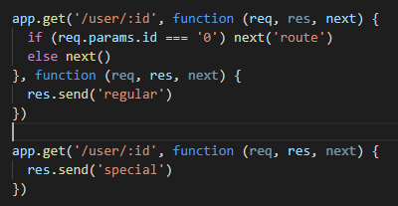
Application Level Middleware
Ravi Kumar Atluri

Slide 22
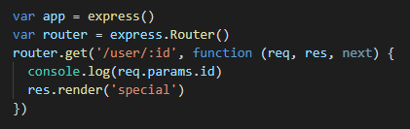
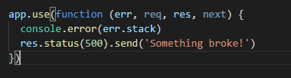
Routing Level Middleware
Error Handling Middleware
Ravi Kumar Atluri

Slide 23

Built-in Middleware
express.static
express.json
express.urlencoded
Third - Party Middleware
Ravi Kumar Atluri

Slide 24

Queries

